Slide 1


Planning with Semantic Attachments: An Object-Oriented View
Andreas Hertle
Christian Dornhege
Thomas Keller
Bernhard Nebel
Elective in Artificial Intelligence
Reasoning Agents
Prof. Fabio Patrizi
Olga Sorokoletova - 1937430

Slide 2
Introduction
Object-oriented Planning Language

Slide 3

Introduction: problem
Battery charging
Space applications
Robotics
Control of hybrid systems
Domain-independent planning has been applied to a rising number of real-world applications
The most common description language for planning tasks is the Planning Domain Definition Language (PDDL)
suited to describe planning problems on an abstract symbolic level
Not sufficient to model subproblems beyond the scope of symbolic planners
geometric computations
object manipulation
navigation
…
…
problem

Slide 4
Introduction: how to solve
Decompose!
Semantic attachments compute the semantics of Boolean fluents by an external process during planning
They are realized as modules
PDDL/M is the slightly modified version of PDDL that allows to attach such a module to a Boolean fluent
TFD/M is a version of the Temporal Fast Downward (TFD) planning system which implements an interface that calls a module
In the implementation of a module it is usually necessary to access the current planning state
To acquire state information from the planning system a module developer must perform manual requests through a callback interface
inefficient!
error-prone!
Hierarchical composition, top-down: specialized planners refine the high-level symbolic plan
Hierarchical composition, bottom-up: information for the symbolic planner is precomputed by the lower level reasoners
Costly
Successful execution is not guaranteed
Semantic Attachments
?

Slide 5
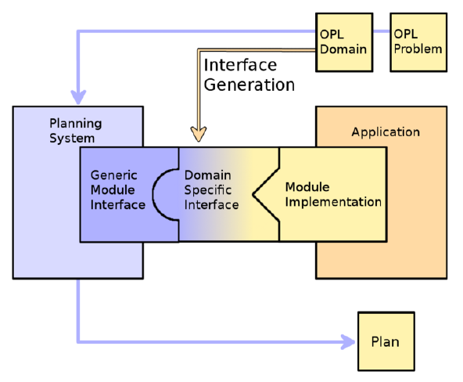
Introduction: how to improve
Object-oriented Planning Language (OPL)!
Incorporates structure and advantages of modern object-oriented programming languages (Java, C++): class definitions for module developers, and objects as instances of these class definitions reflect the current internal planning state - type-safe and efficient access to the internal state of the planning system.

Slide 6
Implementation
Integration of the Components

Slide 7
Implementation: OPL

Slide 8
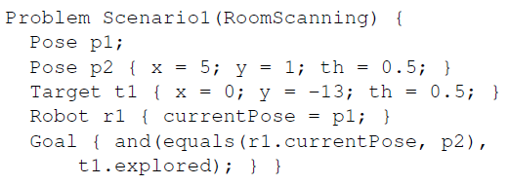
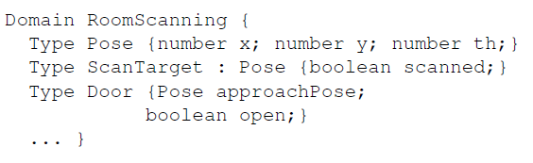
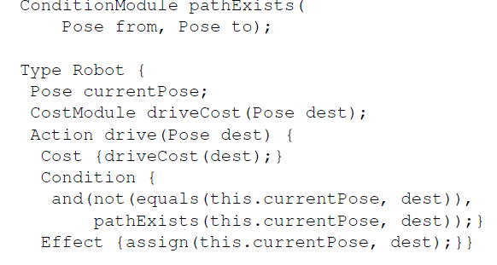
Implementation: OPL
OPL task definitions are separated into a problem and a domain as in PDDL
Like PDDL, types can inherit from other types, but will also inherit the super types’ member fluents and actions. If no base type is specified, it defaults to Object, a built-in type with no members.
Greater importance of types: class declarations
Like PDDL actions, OPL actions have a name and parameters and define a (pre-)condition and an effect
The dot . acts as the structure access operator
The keyword this is used to address the current object in member actions

Slide 9
Implementation: Translation to PDDL

Slide 10
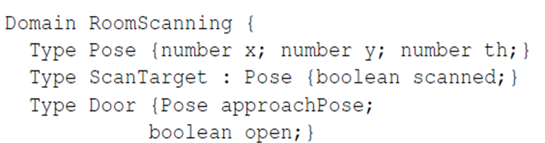

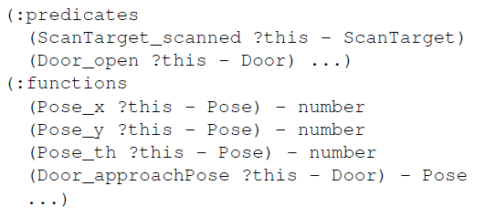
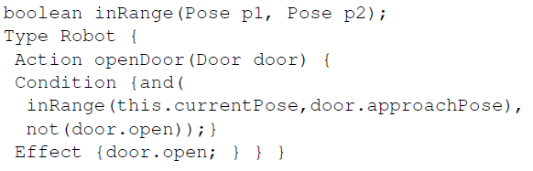
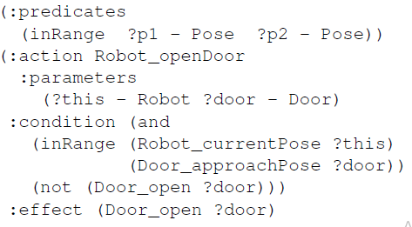
Implementation: OPL to PDDL
Member fluents and actions are specific to an object instance. This is resolved by adding an additional parameter named ?this as the first parameter.
As we allow to chain expressions over member fluents using the .-operator to access structure elements, we need to translate o.m to m ?o <parameters>.

Slide 11
Implementation: Interface Generation

Slide 12
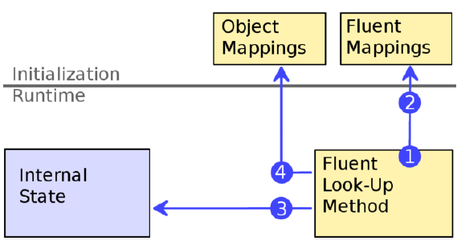
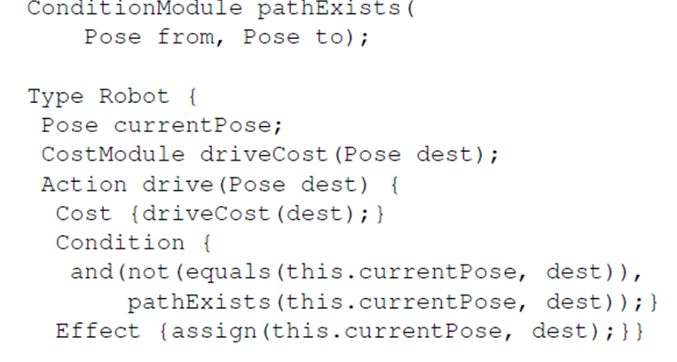
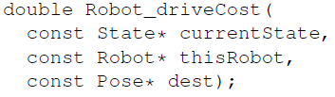
Implementation: interface generation
OPL objects are represented as classes. For TFD/M, this is realized in C++. Module calls receive object instances as parameters.
The generated classes provide member functions for each member fluent to access the planner state. Boolean fluents lead to bool return values and numerical fluents return float values. Object fluents return a pointer to the class
Then to acquire a fluent’s value from the planner’s internal state mapping tables are created. For Boolean and numerical fluents they are used to acquire values directly, for object fluents - by the pointer.

Slide 13
Experiments
TFD/M (with vs without OPL)

Slide 14
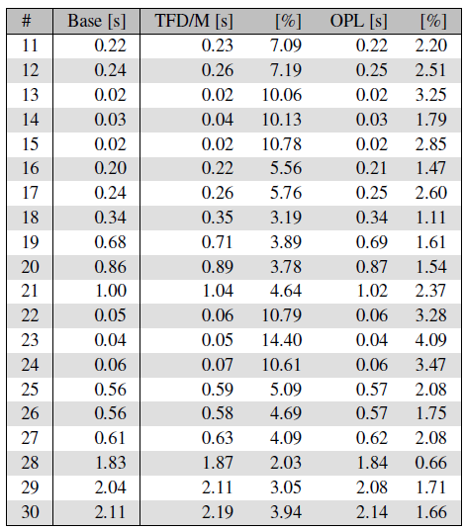
Experiments: International Planning Competition (IPC) 2008
CREW-PLANNING
The experiment is intended to show the computational overhead of TFD/M and OPL compared to a base line planner not using semantic attachments at all.
The module simply acquires one (most common) predicate from the planner state either with the TFD/M generic module interface or via OPL’s domain-specific interface and returns its truth value.
Runtimes in seconds are averaged over 150 trials. The computational overhead in percent is given in comparison to the base line without modules.
Table shows that the runtime scales well for both approaches, and is lower for OPL in all problems instances.

Slide 15
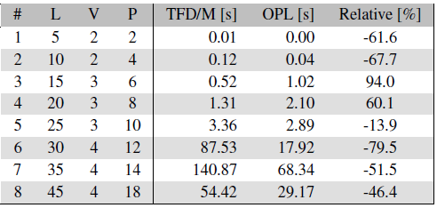
Experiments: International Planning Competition (IPC) 2008
TRANSPORT-NUMERIC
The is designed to show the impact of acquiring fluent values from the planner state.
The domain models a logistics task where packages are transported by trucks. The simple volume based condition check to see if another package can be loaded is replaced by a semantic attachment that checks if the package fits geometrically into the truck given the current cargo.
The module requests the sizes of all packages to be stored in the vehicle and the vehicle’s capacity from the internal planner state.
L, V, P list the number of locations, vehicles and packages for each problem. The last column gives the relative runtime of OPL compared to TFD/M.
The results in the table show that the runtime using the OPL module interface is significantly lower in most cases than the original TFD/M interface’s. This is especially visible in the more complex tasks (6 – 8) as in these cases the time for initialization is negligible. As problems (3 – 4) show, the initialization time might dominate the positive runtime effects for simple tasks.

Slide 16
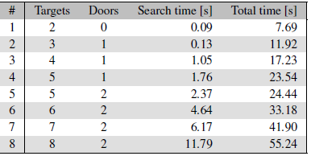
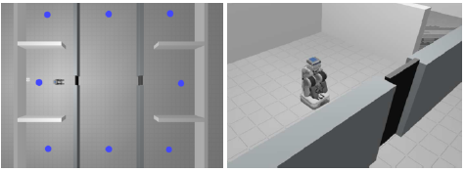
Experiments: real-world environment
ROOM-SCANNING
The main objective of the experiment is to show how a complex system is built easily by integrating an existing path planner into TFD/M using the OPL planner interface.
The domain models an autonomous robot searching for items in various rooms.
The module implementation calculates the real path cost for the drive action by calling the external path planner used by the navigation component of the ROS.
The total time is the time the planner needed to come up with a plan, and the search time is the total time without the runtime of the path planner, separately.
As can be seen in table, the time required to find the first valid plan increases with problem complexity. The observed runtimes are acceptable for use in a real world robotics system and could be improved by using a more efficient path planner.

Slide 17
Conclusion
Personal Comments

Slide 18
Conclusion: personal opinion
OPL framework provides a smooth integration between PDDL and C++ best practices
It furthermore allows to benefit from both domain-independent and domain-specific implementations
A possible disadvantage is that the initialization time might dominate the positive runtime effects for simple tasks
Allowing PDDL based planner to solve OPL task if combined with the tools that are described in the paper could be a good idea to exploit in the project assuming that the task is complex enough and involves geometric computations

Slide 19

Thank you for the listening!

